Slide 1
Bad ggplot contest
Abdeali Jivaji

Slide 2
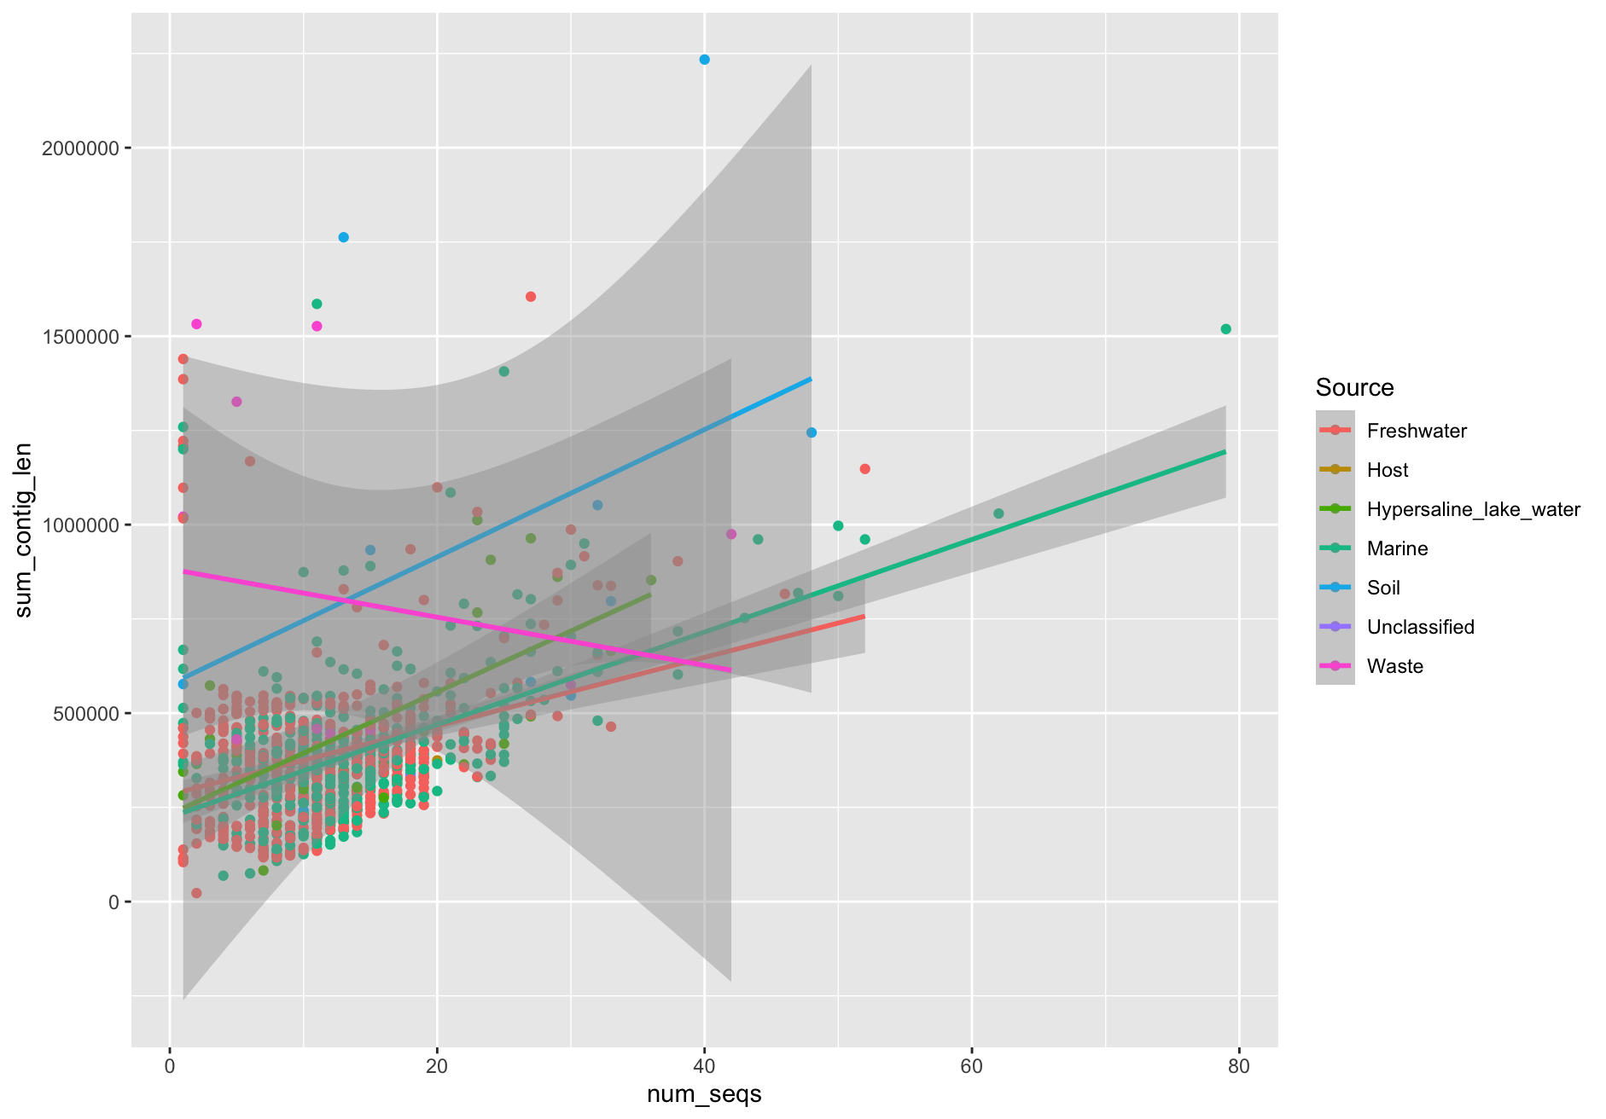
Plot 1

Slide 3
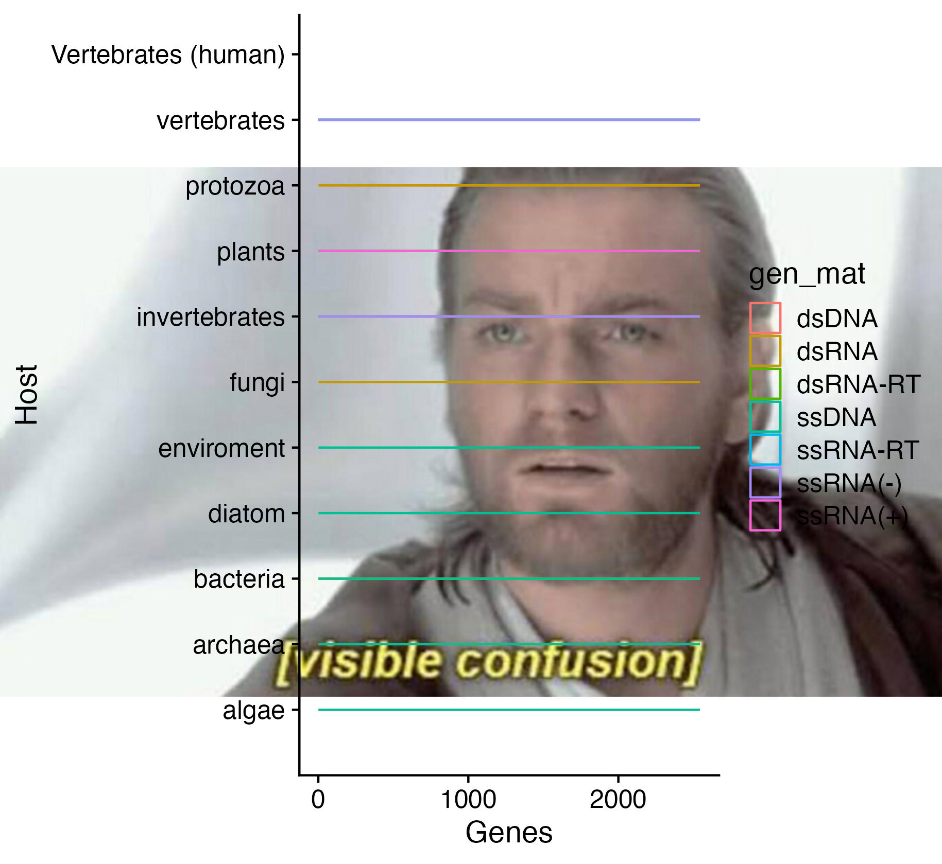
Plot 2

Slide 4
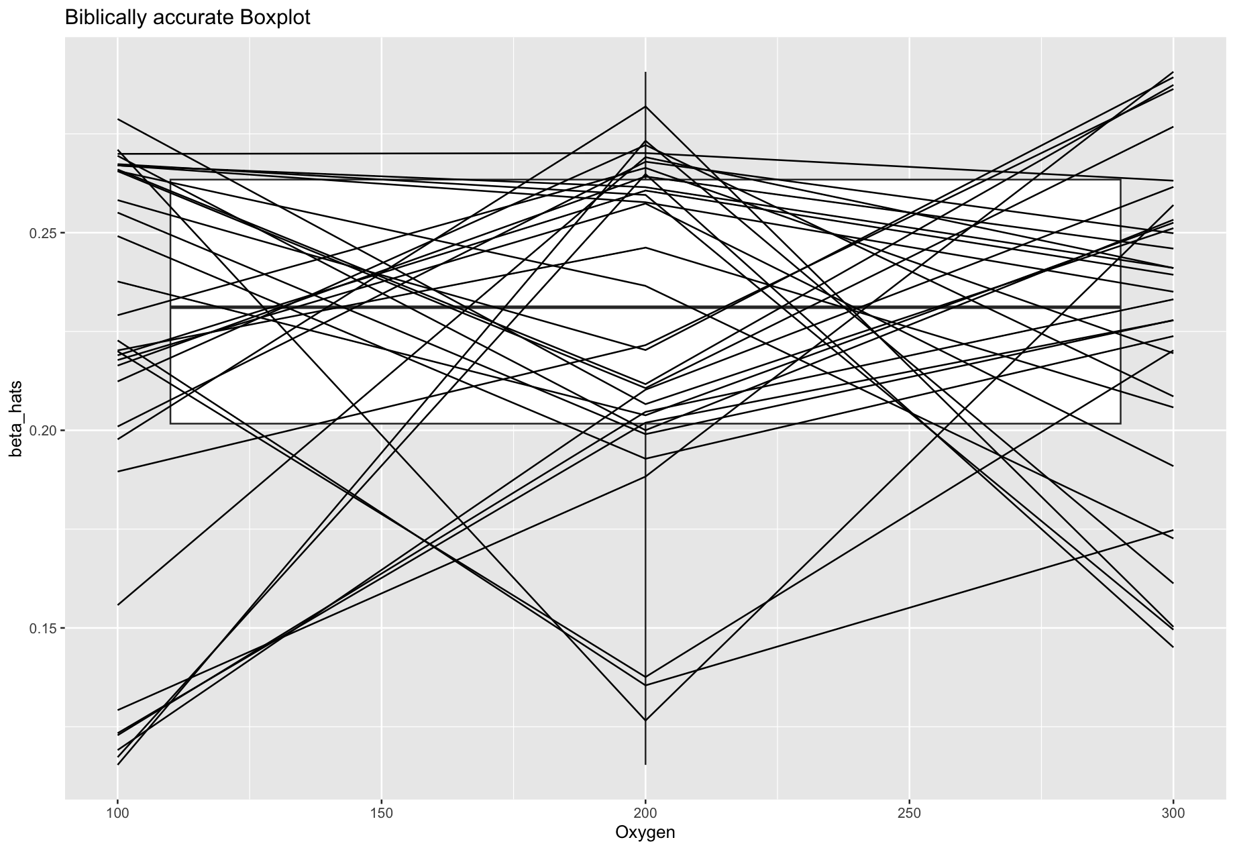
Plot 3

